Slide 1
Software Architecture
Module 5
Techniques in a typical layered Architecture
Harvinder S Jabbal
SEZG651/SSZG653 Software Architectures

Slide 2
Contents
Typical layers in Layered architecture
Techniques used in different layers
February 17, 2024
SEZG651/SSZG653 Software Architectures

Slide 3
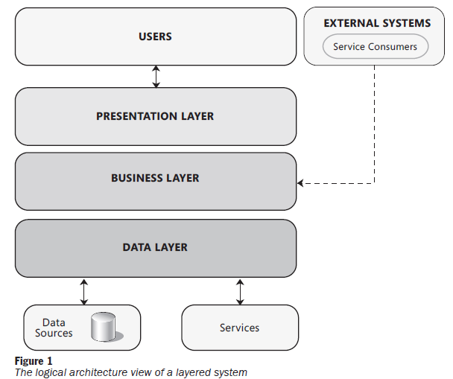
Typical layered architecture
February 17, 2024
SEZG651/SSZG653 Software Architectures

Slide 4

Example of layers in Judiciary system
Citizens & Lawyers
Judges, Court staff
LAN
Firewall
Presentation layer
Case creation screen
Judgement screen
Presentation layer
Case creation
Case scheduling
Case proceedings
Case judgement
Business layer
Generic SMS client
Airtel adaptor
Airtel SMS system
Workflow engine
Vodafone adaptor
Vodafone SMS system
Data access layer
Case DAO
Proceedings
DAO
Schedule DAO
Users
DAO
DB Connections
February 17, 2024
SEZG651/SSZG653 Software Architectures
Firewall
DB server

Slide 5
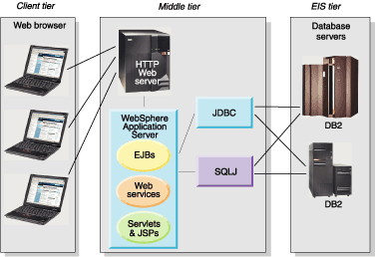
Typical layered architecture
February 17, 2024
SEZG651/SSZG653 Software Architectures

Slide 6
Benefits
What are the benefits of layered architecture?
February 17, 2024
SEZG651/SSZG653 Software Architectures

Slide 7
Characteristics & benefits
Clearly defined functional layers (separation of concerns)
Loose coupling
Reusable lower layer components
Exchangeable parts
February 17, 2024
SEZG651/SSZG653 Software Architectures

Slide 8
Techniques used in different layers
February 17, 2024
SEZG651/SSZG653 Software Architectures

Slide 9
Presentation layer techniques
Cache frequently used data such as Product catalog (Client side caching vs Server side caching)
Use asynchronous communication between UI & Webserver to update parts of the web page without loading the whole web page (ex. AJAX)
Different rendering for different form-factors: Responsive design
February 17, 2024
SEZG651/SSZG653 Software Architectures

Slide 10
Client side caching vs Server side caching
Client-side caching: Here we store frequently used data in the browser of the client machine – example user preference such as payment method, delivery address, etc.
Server-side caching: Here we store frequently used data needed by different back-end modules on the server-side – example: Product codes and description, promotions, etc.
Combination: In practice, a combination the above 2 techniques is used.
February 17, 2024
SEZG651/SSZG653 Software Architectures

Slide 11
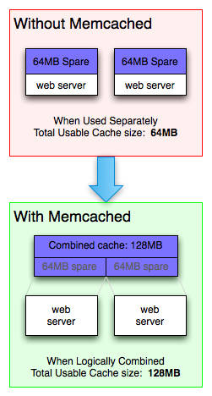
Memcached
memcached is a high-performance, distributed memory object caching system, generic in nature, but originally intended for use in speeding up dynamic web applications by alleviating database load.
You can think of it as a short-term memory for your applications.
memcached allows you to take memory from parts of your system where you have more than you need and make it accessible to areas where you have less than you need.
February 17, 2024
SEZG651/SSZG653 Software Architectures

Slide 12
Asynchronous communication with web server
Example use cases:
Show product list depending on the product category selected by user
Validating a user input such as loan amount - whether it is within permissible limits, depending on user profile
Displaying a chat panel
Reloading Captcha
February 17, 2024
SEZG651/SSZG653 Software Architectures

Slide 13
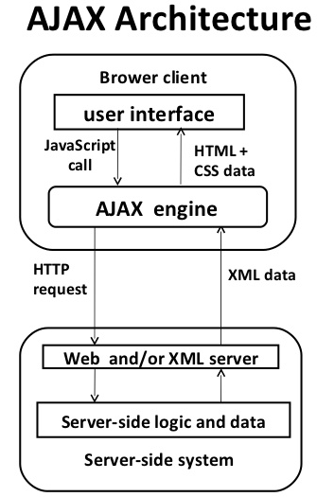
Asynchronous communication with web server
AJAX stands for Asynchronous JavaScript and XML.
AJAX is a technique for creating better, faster, and more interactive web applications with the help of XML, HTML, CSS, and Java Script.
Some famous web applications that use AJAX:
Google Maps (Drag entire map)
Google Suggest (Google suggests as you type)
February 17, 2024
SEZG651/SSZG653 Software Architectures

Slide 14

Responsive web design: Examples
Notice how the layout changes depending on screen size
Responsive web design is an approach that renders web pages well on a variety of devices or screen sizes.
February 17, 2024
SEZG651/SSZG653 Software Architectures

Slide 15
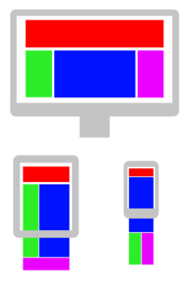
Consider different form factors – Use Responsive design
Ref: Wikipedia
Flexible grids
Allows varying layout depending on screen size
HTML5 and CSS3 help in specifying the display arrangement
February 17, 2024
SEZG651/SSZG653 Software Architectures

Slide 16
Presentation layer
Have you used any other techniques in Presentation layer?
February 17, 2024
SEZG651/SSZG653 Software Architectures

Slide 17
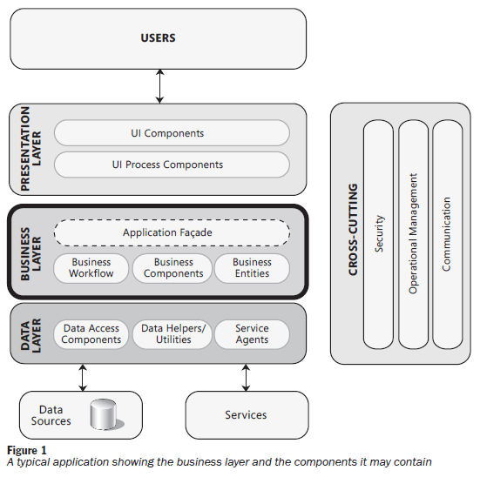
Business layer
February 17, 2024
SEZG651/SSZG653 Software Architectures

Slide 18
Business layer techniques
Use Application façade to hide internal modules
Implement session management
Use Work flow engine, Rules engine, etc. for modifiability
February 17, 2024
SEZG651/SSZG653 Software Architectures

Slide 19
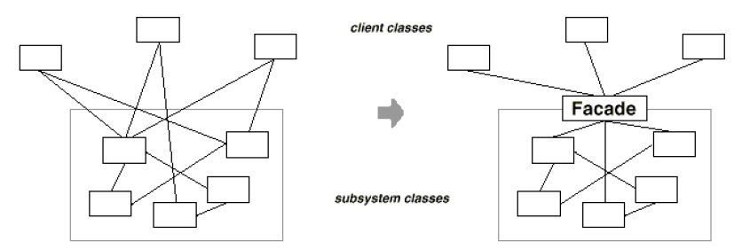
Facade: Making sub-system easier to use
Intent:
Provide a unified interface to a set of interfaces in a subsystem.
Facade defines a higher-level interface that makes the subsystem easier to use.
It typically involves a single wrapper class which contains a set of members required by client.
February 17, 2024
SEZG651/SSZG653 Software Architectures

Slide 20
Example of Application façade: Flight booking
Booking_User_Interace
Get_flt_details
Client
Booking_Engine
Get_flt_details
Server
Schedule
Get_flt_list
Seat Inventory
Get_seat_availability
Pricing
Get_flt_price
February 17, 2024
SEZG651/SSZG653 Software Architectures

Slide 21

Session management
Instance 1
Web Server
Req #1
Add to Cart
Req #1
Browser
Session state
Prod id1. Qty
Prod id 2, Qty
Req #2
Instance 2
Add to Cart
Client based state mgmt. (cookies)
Server based session mgmt. (persistent)
Req #2
February 17, 2024
SEZG651/SSZG653 Software Architectures

Slide 22
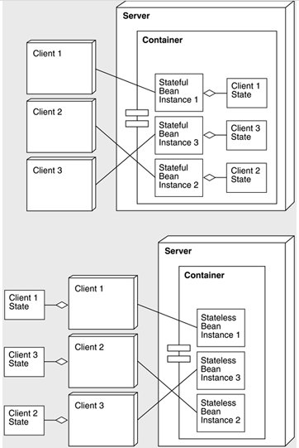
EJB: Stateless & Stateful session beans
J2EE server
EJB Container
Stateful session Bean: All requests from a Client goes to the same instance of the Bean.
Bean maintains the state of the session
J2EE server
EJB Container
Stateless session Bean: Subsequent request from a client to a Bean may go to another instance of the Bean
Hence Client needs to main the state of the session
February 17, 2024
SEZG651/SSZG653 Software Architectures

Slide 23
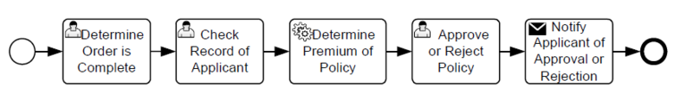
Work flow engine
Insurance policy processing
Example Activities
Once an activity is completed, the engine invokes the next step in the process
The next step / activity could be a manual one or an automated one
Popular engines: BizTalk Server, Oracle BPEL processor, IBM WebSphere Process Server
February 17, 2024
SEZG651/SSZG653 Software Architectures

Slide 24
Aspect oriented design for cross cutting concerns
Aspect Oriented design aims to encapsulate cross-cutting concerns into aspects (enhancing modularity)
Examples of aspects:
Logging & instrumentation
Auditing: Who is doing what
Caching
Security
February 17, 2024
SEZG651/SSZG653 Software Architectures

Slide 25
Aspect Oriented Design
Different aspects of the system
They cut across layers
Modules in different layers call the modules in the cross-cutting sub-system at different points in time
February 17, 2024
SEZG651/SSZG653 Software Architectures

Slide 26
Logging & instrumentation
Log actionable information such as errors
  “Database is unavailable”
  Information useful to diagnose errors
Logging is expensive. Log only the most essential data
Instrumentation helps in understanding the usage & behaviour of the system
  Request rate
  Error rate
  Duration of requests
  Queue length
Ref: https://peter.bourgon.org/blog/2016/02/07/logging-v-instrumentation.html
February 17, 2024
SEZG651/SSZG653 Software Architectures

Slide 27
Business layer
We saw:
Façade
Session mangement
Work flow engine
Aspect oriented design
Have you used any other technique in Business layer?
February 17, 2024
SEZG651/SSZG653 Software Architectures

Slide 28
Data layer: Prominent techniques used
Use DB connection pool, if there are too many users
Use multiple copies of data for faster access
Use transactions to achieve atomicity
Use Object - Relational mapping
Use stored procedures to improve performance
Use parameterized SQL queries to reduce SQL injection attacks
February 17, 2024
SEZG651/SSZG653 Software Architectures

Slide 29
Object-Relational mapping
Helps in mapping objects in our program to database table
Hibernate is a framework that provides an Object/Relational Mapping (O/RM)
February 17, 2024
SEZG651/SSZG653 Software Architectures

Slide 30
SQL Injection attacks
Do not concatenate user entered string to SQL string
  Malicious input can result in the following:
  SELECT product-data FROM table WHERE product-name = ‘Toothpaste’ OR ‘x’ = ‘x’;
  This will return all product data
Use parameterized SQL queries
  SELECT product-data FROM table WHERE product-name = ?
  ? Is a parameter which contains the value entered by user
February 17, 2024
SEZG651/SSZG653 Software Architectures

Slide 31
Data layer
Have you used any other technique in Data layer?
February 17, 2024
SEZG651/SSZG653 Software Architectures

Slide 32
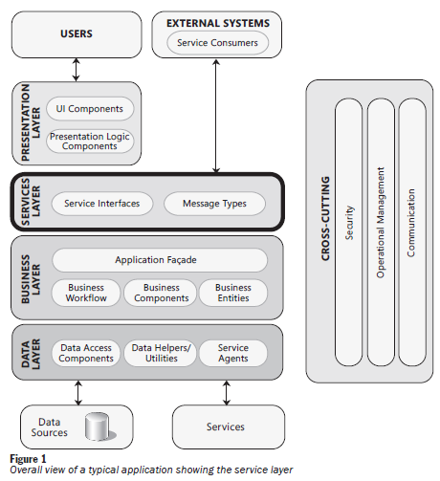
Services layer
Get Balance (A/c #)
Provides services to external systems
Example: A bank may provide following services to external systems:
Get Balance
Request chequebook
February 17, 2024
SEZG651/SSZG653 Software Architectures

Slide 33
Service layer
Situations that need to be handled by service layer
Handle same request coming twice
Handle message coming out of sequence
Handle communication failure (using retry mechanism or by queuing work and sending once communication is restored)
February 17, 2024
SEZG651/SSZG653 Software Architectures

Slide 34
Question
Have you used any other techniques in a layered architecture?
February 17, 2024
SEZG651/SSZG653 Software Architectures

Slide 35
Exercise 1
What are some of the components of Departure Control System in
  Presentation layer
  Business layer
  Data layer
  Service layer
February 17, 2024
SEZG651/SSZG653 Software Architectures

Slide 36
Exercise: Identify components in different layers of DCS
February 17, 2024
SEZG651/SSZG653 Software Architectures

Slide 37
Exercise 2
What software mechanism will you use to improve the performance in the following situation:
One of the frequently used screens in Aadhaar system is citizen registration.
This screen has a fields “State” and “District” and “Town”, which are Drop-down fields
It takes time to loading this screen due to the large number of states, districts and towns in India
February 17, 2024
SEZG651/SSZG653 Software Architectures

Slide 38
Solution
Cache states, districts and towns in the backend
Use AJAX for dynamic loading of districts and towns
February 17, 2024
SEZG651/SSZG653 Software Architectures

Slide 39
Exercise 3:
Suppose you are developing a hotel reservation system.
You want to provide is an interface to externals applications such as Makemytrip.com, to inquire about availability of rooms and book rooms.
What layer would you build and what will be the component (s) in that layer?
February 17, 2024
SEZG651/SSZG653 Software Architectures

Slide 40
Answer
Services layer is needed to provide interface to external systems.
This layer will have components such as
  Get room availability (from date, to date) return (# rooms available by type of room)
  Reserve room (# of rooms, type of room, from date, to date) Return (Success / Failure)
February 17, 2024
SEZG651/SSZG653 Software Architectures

Slide 41
Exercise 4
Suppose you are building a complex logistics system for a shipping & container company
Users wanting to send goods via containers will login to the system and place their requests
A number of modules need to be called for this:
  Find out the nearest location of an empty container
  Find a the best transporter to pick up the goods
  Find a ship that is scheduled leave to the desired destination and has spare capacity to load the container
As an architect you want to hide these modules from the client layer.
What technique will you use and in which layer?
February 17, 2024
SEZG651/SSZG653 Software Architectures

Slide 42
Answer
In the Business layer, provide a unified API – façade - to place a shipping request
The façade will in turn make use of modules to search for appropriate container, appropriate transporter, appropriate ship, etc.
February 17, 2024
SEZG651/SSZG653 Software Architectures

Slide 43
Appendix
February 17, 2024
SEZG651/SSZG653 Software Architectures

Slide 44
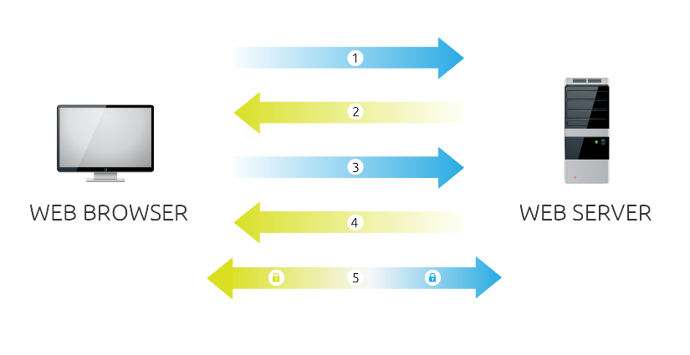
SSL
Browser connects to a web server (website) secured with SSL (https). Browser requests that the server identify itself.
Server sends a copy of its SSL Certificate, including the server’s public key.
Browser checks the certificate root against a list of trusted CAs and that the certificate is unexpired, unrevoked, and that its common name is valid for the website that it is connecting to. If the browser trusts the certificate, it creates, encrypts, and sends back a symmetric session key using the server’s public key.
Server decrypts the symmetric session key using its private key and sends back an acknowledgement encrypted with the session key to start the encrypted session.
Server and Browser now encrypt all transmitted data with the session key.
February 17, 2024
SEZG651/SSZG653 Software Architectures

Slide 45
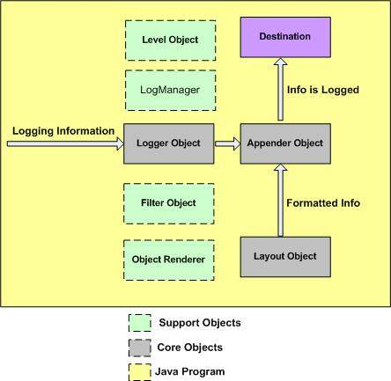
Logging: Apache Log4j
Database, file, console, UNIX Syslog, etc.
Logging is an important component of the software development.
A well-written logging code offers quick debugging, easy maintenance, and structured storage of an application's runtime information.
Logging does have its drawbacks also. It can slow down an application.
capturing logging information
format logging information
February 17, 2024
SEZG651/SSZG653 Software Architectures

Slide 46

SSL
Browser requests that the server identify itself.
Server sends a copy of its SSL Certificate
Browser checks the certificate. and sends back a symmetric session key
Server sends back an acknowledgement.
Server and Browser now encrypt all transmitted data with the session key.
February 17, 2024
SEZG651/SSZG653 Software Architectures

Slide 47
IPSec – Internet Protocol Security
IPSec is an Internet Engineering Task Force (IETF) standard suite of protocols that provides data authentication, integrity, and confidentiality as data is transferred between communication points across IP networks.
IPSec provides data security at the IP packet level.
February 17, 2024
SEZG651/SSZG653 Software Architectures

Slide 48
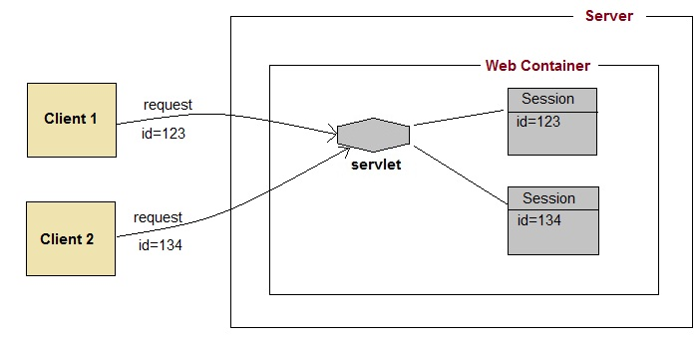
Session management
A web session is a sequence of network HTTP request and response transactions associated to the same user.
Modern and complex web applications require the retaining of information or status about each user for the duration of multiple requests.
February 17, 2024
SEZG651/SSZG653 Software Architectures

